Slide 1

Chapter 8
Cluster Analysis
Copyright © 2007
Prentice-Hall, Inc.

Slide 2
Chapter 8: Cluster Analysis
LEARNING OBJECTIVES:
Upon completing this chapter, you should be able to do the following:
Define cluster analysis, its roles and its limitations.
Identify the research questions addressed by cluster analysis.
Understand how interobject similarity is measured.
Distinguish between the various distance measures.
Differentiate between clustering algorithms.
Understand the differences between hierarchical and nonhierarchical clustering techniques.
Describe how to select the number of clusters to be formed.
Follow the guidelines for cluster validation.
Construct profiles for the derived clusters and assess managerial significance.

Slide 3

Cluster Analysis Overview
What is it?
Why use it?

Slide 4
Cluster Analysis Defined
Cluster analysis . . . groups objects (respondents, products, firms, variables, etc.) so that each object is similar to the other objects in the cluster and different from objects in all the other clusters.

Slide 5
What is Cluster Analysis?
Cluster analysis . . . is a group of multivariate techniques whose primary purpose is to group objects based on the characteristics they possess.
It has been referred to as Q analysis, typology construction, classification analysis, and numerical taxonomy.
The essence of all clustering approaches is the classification of data as suggested by “natural” groupings of the data themselves.

Slide 6
Criticisms of Cluster Analysis
The following must be addressed by conceptual rather than empirical support:
Cluster analysis is descriptive, atheoretical, and noninferential.
. . . will always create clusters, regardless of the actual existence of any structure in the data.
The cluster solution is not generalizable because it is totally dependent upon the variables used as the basis for the similarity measure.

Slide 7
Two Variable Cluster Analysis
Low Frequency of Eating Out High
3
1
2
Low Frequency of Going to Fast Food Restaurants High

Slide 8
Cluster Analysis of Eating Out Statements
I eat out as often as I can.
I eat out at fast food restaurants at least once a week.
I prefer restaurants that have quick service.
Eating at home is better than eating out.
I prefer to eat at restaurants that have a nice atmosphere.
I prefer restaurants with the highest quality food.
Objective: Identify groups that maximize ratio of
between groups variance large
within groups variance small
=
1
7
7-point Agree/Disagree Scale

Slide 9
Three Cluster Diagram Showing
Between-Cluster and Within-Cluster Variation
Between-Cluster Variation = Maximize
Within-Cluster Variation = Minimize

Slide 10
Scatter Diagram for Cluster Observations
Frequency of eating out
High
Low
Low High
Frequency of going to fast food restaurants

Slide 11
Scatter Diagram for Cluster Observations
Frequency of eating out
High
Low
Low High
Frequency of going to fast food restaurants

Slide 12
Scatter Diagram for Cluster Observations
Frequency of eating out
High
Low
Low High
Frequency of going to fast food restaurants

Slide 13
Scatter Diagram for Cluster Observations
High
Low
Low High
Frequency of eating out
Frequency of going to fast food restaurants

Slide 14
Comparison of Score Profiles for Factor
Analysis and Hierarchical Cluster Analysis
Variables
Respondent 1 2 3
A 7 6 7
B 6 7 6
C 4 3 4
D 3 4 3
7
6
5
4
3
2
1
Score
Respondent A
Respondent B
Respondent C
Respondent D

Slide 15
What Can We Do With Cluster Analysis?
Determine if statistically different clusters exist.
Identify the meaning of the clusters.
Explain how the clusters can be used.

Slide 16
Stage 1: Objectives of Cluster Analysis
Primary Goal = to partition a set of objects into two or more groups based on the similarity of the objects for a set of specified characteristics (the cluster variate).
There are two key issues:
The research questions being addressed, and
The variables used to characterize objects in the clustering process.

Slide 17
Research Questions in Cluster Analysis
Three basic research questions:
How to form the taxonomy – an empirically based classification of objects.
How to simplify the data – by grouping observations for further analysis.
Which relationships can be identified – the process reveals relationships among the observations.

Slide 18
Selection of Clustering Variables
Two Issues:
Conceptual considerations, and
Practical considerations.

Slide 19
Rules of Thumb 8–1
OBJECTIVES OF CLUSTER ANALYSIS
Cluster analysis is used for:
Taxonomy description – identifying natural groups within the data.
    Data simplification – the ability to analyze groups of similar observations instead of all individual observations.
    Relationship identification – the simplified structure from cluster analysis portrays relationships not revealed otherwise.
Theoretical, conceptual and practical considerations must be observed when selecting clustering variables for cluster analysis:
    Only variables that relate specifically to objectives of the cluster analysis are included, since “irrelevant” variables can not be excluded from the analysis once it begins
    Variables are selected which characterize the individuals (objects) being clustered.

Slide 20
Stage 2: Research Design in Cluster Analysis
    Four Questions:
    Is the sample size adequate?
    Can outliers be detected an, if so, should they be deleted?
    How should object similarity be measured?
    Should the data be standardized?

Slide 21
Plot of Seven Respondent’s Answers to Five Questions
10
8
6
4
2
0
X₁ X₂ X₃ X₄ X₅
1
2
3
7
4
6
5
Value
Variable

Slide 22
Measuring Similarity
Interobject similarity is an empirical measure of correspondence, or resemblance, between objects to be clustered. It can be measured in a variety of ways, but three methods dominate the applications of cluster analysis:
  Correlational Measures.
  Distance Measures.
  Association.

Slide 23
Types of Distance Measures
Euclidean distance.
Squared (or absolute) Euclidean distance.
City-block (Manhattan) distance.
Chebychev distance.
Mahalanobis distance (D²).

Slide 24
Rules of Thumb 8 – 2
    RESEARCH DESIGN IN CLUSTER ANALYSIS
    The sample size required is not based on statistical considerations for inference testing, but rather:
      Sufficient size is needed to ensure representativeness of the population and its underlying structure, particularly small groups within the population.
      Minimum group sizes are based on the relevance of each group to the research question and the confidence needed in characterizing that group.
    Similarity measures calculated across the entire set of clustering variables allow for the grouping of observations and their comparison to each other.
      Distance measures are most often used as a measure of similarity, with higher values representing greater dissimilarity (distance between cases) not similarity.
      There are many different distance measures, including:
      Euclidean (straight line) distance is the most common measure of distance.
      Squared Euclidean distance is the sum of squared distances and is the recommended measure for the centroid and Ward’s methods of clustering.
      Mahalanobis distance accounts for variable intercorrelations and weights each variable equally. When variables are highly intercorrelated, Mahalanobis distance is most appropriate.
      Less frequently used are correlational measures, where large values do indicate similarity.
    Given the sensitivity of some procedures to the similarity measure used, the researcher should employ several distance measures and compare the results from each with other results or theoretical/known patterns.

Slide 25
Rules of Thumb 8 – 2 Continued . . .
    RESEARCH DESIGN IN CLUSTER ANALYSIS
    Outliers can severely distort the representativeness of the results if they appear as structure (clusters) that are inconsistent with the research objectives
      They should be removed if the outlier represents:
      Aberrant observations not representative of the population
      Observations of small or insignificant segments within the population which are of no interest to the research objectives
      They should be retained if representing an under-sampling/poor representation of relevant groups in the population. In this case, the sample should be augmented to ensure representation of these groups.
    Outliers can be identified based on the similarity measure by:
      Finding observations with large distances from all other observations
      Graphic profile diagrams highlighting outlying cases
      Their appearance in cluster solutions as single-member or very small clusters
    Clustering variables should be standardized whenever possible to avoid problems resulting from the use of different scale values among clustering variables.
      The most common standardization conversion is Z scores.
      If groups are to be identified according to an individual’s response style, then within-case or row-centering standardization is appropriate.

Slide 26
Stage 3: Assumptions of Cluster Analysis
    Representativeness of the sample.
    Impact of multicollinearity.

Slide 27
Rules of Thumb 8 – 3
    ASSUMPTIONS IN CLUSTER ANALYSIS
    Input variables should be examined for substantial multicollinearity and if present:
      Reduce the variables to equal numbers in each set of correlated measures, or
      Use a distance measure that compensates for the correlation, like Mahalanobis Distance.

Slide 28
Stage 4: Deriving Clusters and Assessing Overall Fit
    The researcher must:
    Select the partitioning procedure used for forming clusters, and
    Make the decision on the number of clusters to be formed.

Slide 29
Using Cluster Analysis
Extraction Method?
    Hierarchical
    Nonhierarchical
Number of Clusters?

Slide 30
Two Types of Hierarchical
Clustering Procedures
Agglomerative Methods (buildup)
Divisive Methods (breakdown)

Slide 31
How Agglomerative Approaches Work?
Start with all observations as their own cluster.
Using the selected similarity measure, combine the two most similar observations into a new cluster, now containing two observations.
Repeat the clustering procedure using the similarity measure to combine the two most similar observations or combinations of observations into another new cluster.
Continue the process until all observations are in a single cluster.

Slide 32
Dendogram of Hierarchical Clustering
1
2
3
4
5
6
7
8
1 2 3 4 5 6 7
Agglomerative
Observation Number
Divisive

Slide 33
Agglomerative Algorithms
Single Linkage (nearest neighbor)
Complete Linkage (farthest neighbor)
Average Linkage.
Centroid Method.
Ward’s Method.

Slide 34
Example of Single Linkage
Joining Dissimilar Points A and B
A
B

Slide 35
Comparison of Distance Measures for Single Linkage and Complete Linkage
Shortest
Longest
Single linkage Complete linkage

Slide 36
How Nonhierarchical Approaches Work?
Specify cluster seeds.
Assign each observation to one of the seeds based on similarity.

Slide 37
Selecting Seed Points
Researcher specified.
Sample generated.

Slide 38
Nonhierarchical Cluster Software
SAS FASTCLUS = first cluster seed is first observation in data set with no missing values.
SPSS QUICK CLUSTER = seed points are user supplied or selected randomly from all observations.

Slide 39
Nonhierarchical Clustering Procedures
Sequential Threshold = selects one seed point, develops cluster; then selects next seed point and develops cluster, and so on.
Parallel Threshold = selects several seed points simultaneously, then develops clusters.
Optimization = permits reassignment of objects.

Slide 40
Rules of Thumb 8 – 4
    DERIVING CLUSTERS
    Hierarchical clustering methods differ in the method of representing similarity between clusters, each with advantages and disadvantages:
      Single-linkage is probably the most versatile algorithm, but poorly delineated cluster structures within the data produce unacceptable snakelike “chains” for clusters.
      Complete linkage eliminates the chaining problem, but only considers the outermost observations in a cluster, thus impacted by outliers.
      Average linkage is based on the average similarity of all individuals in a cluster and tends to generate clusters with small within-cluster variation and is less affected by outliers.
      Centroid linkage measures distance between cluster centroids and like average linkage, is less affected by outliers.
      Ward’s is based on the total sum of squares within clusters and is most appropriate when the researcher expects somewhat equally sized clusters. But it is easily distorted by outliers.
    Nonhierarchical clustering methods require that the number of clusters be specified before assigning observations:
      The sequential threshold method assigns observations to the closest cluster, but an observation cannot be re-assigned to another cluster following its original assignment.
      Optimizing procedures allow for re-assignment of observations based on the sequential proximity of observations to clusters formed during the clustering process.

Slide 41
Rules of Thumb 8 – 4 Continued . . .
    DERIVING CLUSTERS
    Selection of hierarchical or nonhierarchical methods is based on:
      Hierarchical clustering solutions are preferred when:
      A wide range, even all, alternative clustering solutions is to be examined
      The sample size is moderate (under 300-400, not exceeding 1,000) or a sample of the larger dataset is acceptable
      Nonhierarchical clustering methods are preferred when:
      The number of clusters is known and initial seed points can be specified according to some practical, objective or theoretical basis.
      There is concern about outliers since nonhierarchical methods generally are less susceptible to outliers.
    A combination approach using a hierarchical approach followed by a nonhierarchical approach is often advisable.
      A nonhierarchical approach is used to select the number of clusters and profile cluster centers that serve as initial cluster seeds in the nonhierarchical procedure.
      A nonhierarchical method then clusters all observations using the seed points to provide more accurate cluster memberships.

Slide 42
Stage 5: Interpretation of the Clusters
      This stage involves examining each cluster in terms of the cluster variate to name or assign a label accurately describing the nature of the clusters

Slide 43
Stage 6: Validation and Profiling of the Clusters
Validation:
Cross-validation.
Criterion validity.
Profiling: describing the characteristics of each cluster to explain how they may differ on relevant dimensions. This typically involves the use of discriminant analysis or ANOVA.

Slide 44
Rules of Thumb 8–5
DERIVING THE FINAL CLUSTER SOLUTION
There is no single objective procedure to determine the ‘correct’ number of clusters. Rather the researcher must evaluate alternative cluster solutions on the following considerations to select the “best” solution:
    Single-member or extremely small clusters are generally not acceptable and should generally be eliminated.
    For hierarchical methods, ad hoc stopping rules, based on the rate of change in a total similarity measure as the number of clusters increases or decreases, are an indication of the number of clusters.
    All clusters should be significantly different across the set of clustering variables.
    Cluster solutions ultimately must have theoretical validity assess through external validation.

Slide 45
Rules of Thumb 8–6
INTERPRETING, PROFILING AND VALIDATING CLUSTERS
The cluster centroid, a mean profile of the cluster on each clustering variable, is particularly useful in the interpretation stage.
    Interpretation involves examining the distinguishing characteristics of each cluster’s profile and identifying substantial differences between clusters
    Cluster solutions failing to show substantial variation indicate other cluster solutions should be examined.
    The cluster centroid should also be assessed for correspondence with the researcher’s prior expectations based on theory or practical experience.
Validation is essential in cluster analysis since the clusters are descriptive of structure and require additional support for their relevance:
  Cross-validation empirically validates a cluster solution by creating two sub-samples (randomly splitting the sample) and then comparing the two cluster solutions for consistency with respect to number of clusters and the cluster profiles.
  Validation is also achieved by examining differences on variables not included in the cluster analysis but for which there is a theoretical and relevant reason to expect variation across the clusters.

Slide 46
How does cluster analysis work?
Three Basic Questions:
How to measure similarity?
How to form clusters?
(extraction method)
3. How many clusters?

Slide 47
Answers to First Two Basic Questions
How to measure similarity?
  Distance = squared Euclidean.
How to form clusters?
  Hierarchical = Wards method.

Slide 48
Third Basic Question: How many clusters?
Run cluster; examine solutions for two, three, four, etc. clusters ??
Select number of clusters based on “a priori” criteria, practical judgement, common sense, theoretical foundations, and statistical significance.

Slide 49
Steps in Cluster Analysis
Identify the variables to be clustered.
Determine if clusters exist. To do so, verify the clusters are statistically different and theoretically meaningful (a logical name can be assigned).
Make an initial decision on how many clusters to use.
Where possible, validate clusters using an external variable.
Describe the characteristics of the derived clusters using demographics, psychographics, etc.

Slide 50
Description of HBAT Primary Database Variables
Variable Description Variable Type
Data Warehouse Classification Variables
X1 Customer Type nonmetric
X2 Industry Type nonmetric
X3 Firm Size nonmetric
X4 Region nonmetric
X5 Distribution System nonmetric
Performance Perceptions Variables
X6 Product Quality metric
X7 E-Commerce Activities/Website metric
X8 Technical Support metric
X9 Complaint Resolution metric
X10 Advertising metric
X11 Product Line metric
X12 Salesforce Image metric
X13 Competitive Pricing metric
X14 Warranty & Claims metric
X15 New Products metric
X16 Ordering & Billing metric
X17 Price Flexibility metric
X18 Delivery Speed metric
Outcome/Relationship Measures
X19 Satisfaction metric
X20 Likelihood of Recommendation metric
X21 Likelihood of Future Purchase metric
X22 Current Purchase/Usage Level metric
X23 Consider Strategic Alliance/Partnership in Future nonmetric

Slide 51
Using SPSS to Identify Clusters:
For this example we are looking for subgroups among all the HBAT customers using the variables for the “Postsale Customer Service” factor derived in Chapter 3. The SPSS click through sequence is: Analyze → Classify → Hierarchical Cluster. This will take you to a dialog box where you select and move variables X₉, X₁₆ and X₁₈ into the “Variables” box. Now look at the other options below. We will use all the defaults shown on the dialog box as well as the defaults for the Statistics and Plots options below. Next click on the Method box and select Ward’s under Cluster Method (it is the last one and you must scroll down). Squared Euclidean Distances is the default under Measure and we will use it. At this point we will not need the Save option so click on “OK” to run the program.
When the program finishes look for a table called Agglomeration Schedule. There are lots of numbers in it, but at this point we only use the numbers in the Coefficients column (middle of table). At the bottom of the agglomeration schedule table find the numbers in the Coefficients column. The number at the bottom will be the largest. As you move up the column the numbers (error coefficients) get smaller. For example, the bottom number is 283.376 and the one right above it is 112.641.

Slide 52
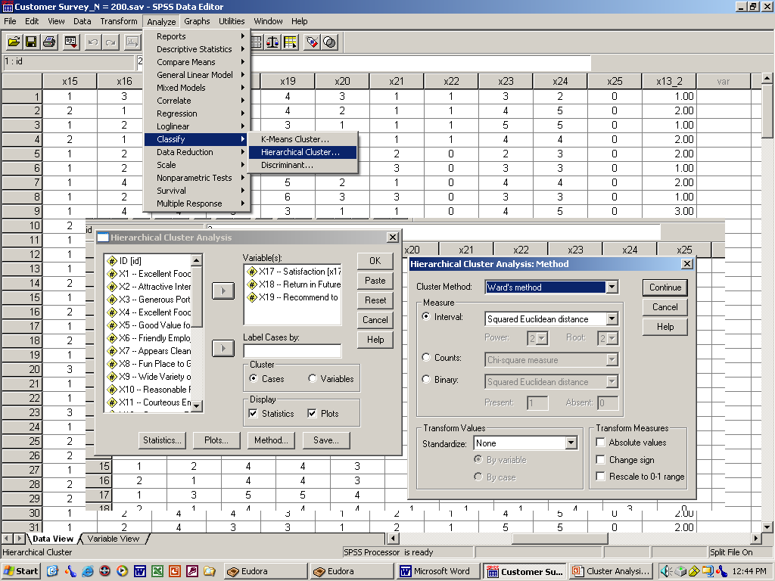
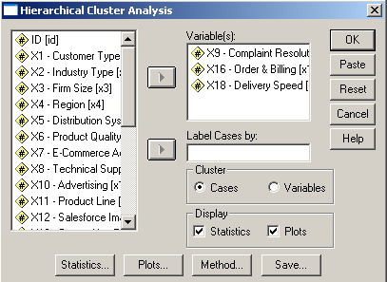
Dialog Boxes for SPSS Cluster

Slide 53
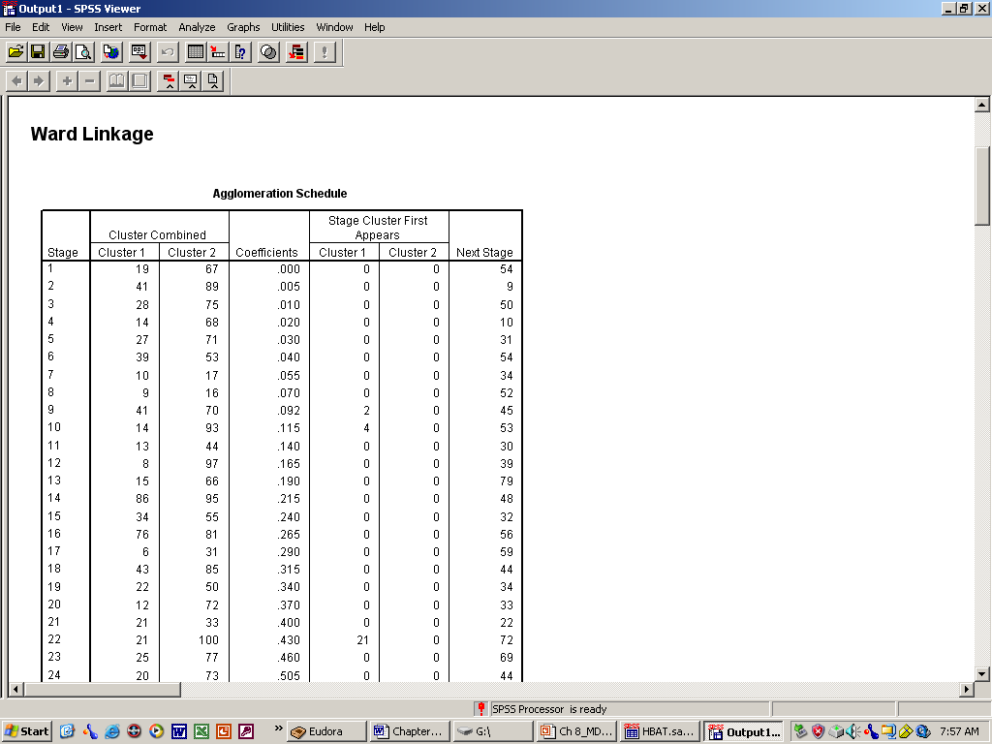
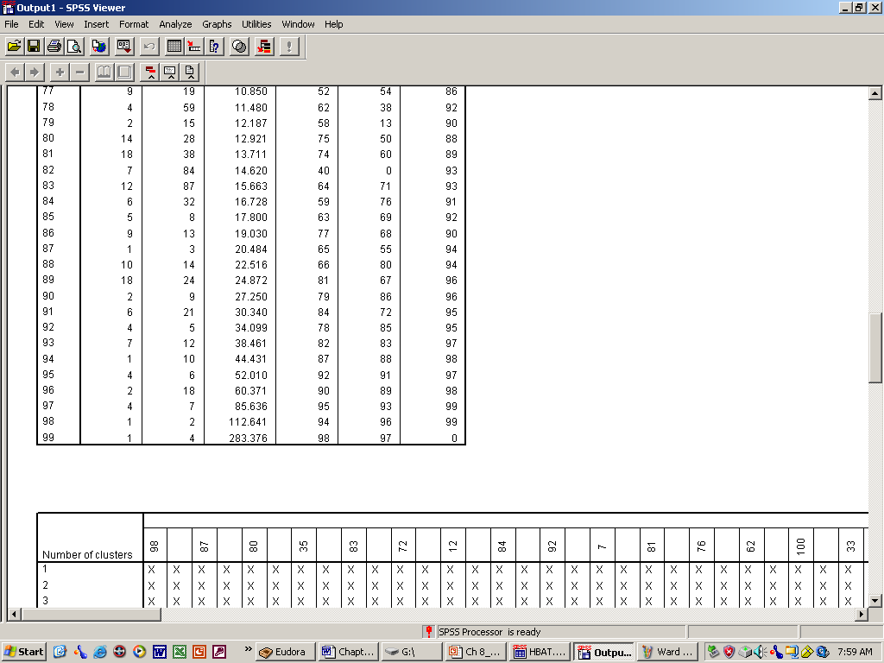
Error Coefficients for Cluster Solution
Error Coefficients
This is at the bottom of the Agglomeration Schedule

Slide 54
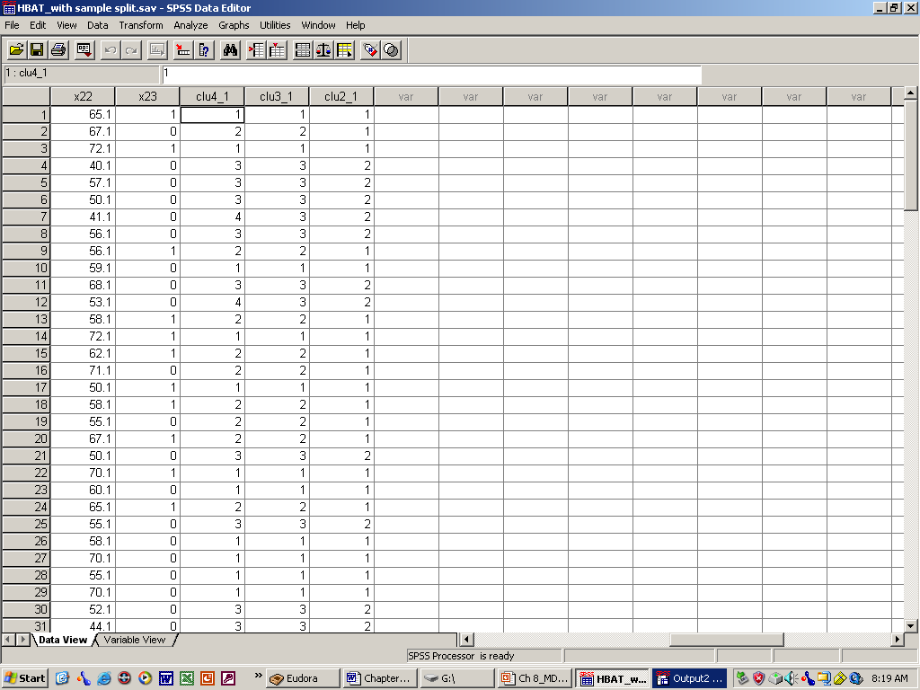
New Cluster Variables
New 2-group, 3-group and 4-group variables.

Slide 55
Cluster Analysis
Learning Checkpoint
Why might we use cluster analysis?
What are the three major steps in cluster analysis?
How do you decide how many clusters
to extract?
Why do we validate clusters?

